Slide 1

MANUFACTURING ANALYSIS
GOWTHAMI YEPURI
CHANDRIKA.P
HARI BABU.N
GOURI

Slide 2

ABOUT THE PROJECT
Manufacturing projects are initiatives aimed at creating or improving systems, processes, and facilities to produce goods efficiently and effectively. These projects typically involve the integration of advanced technologies, resource planning, and quality management to achieve specific goals such as cost reduction, productivity enhancement, or product innovation.
In a manufacturing project, the focus is on designing and implementing solutions that ensure smooth production processes while meeting industry standards and customer expectations.

Slide 3

KEY CHALLANGES
Data Quality and Completeness
Employee and Machine Performance
Department-Level Inefficiencies
Operational Inefficiencies
Scalability and Wastage
Data Integration and Granularity
Visualization and Insights
Process and Quality Control

Slide 4
EXCEL DASHBOARD

Slide 5
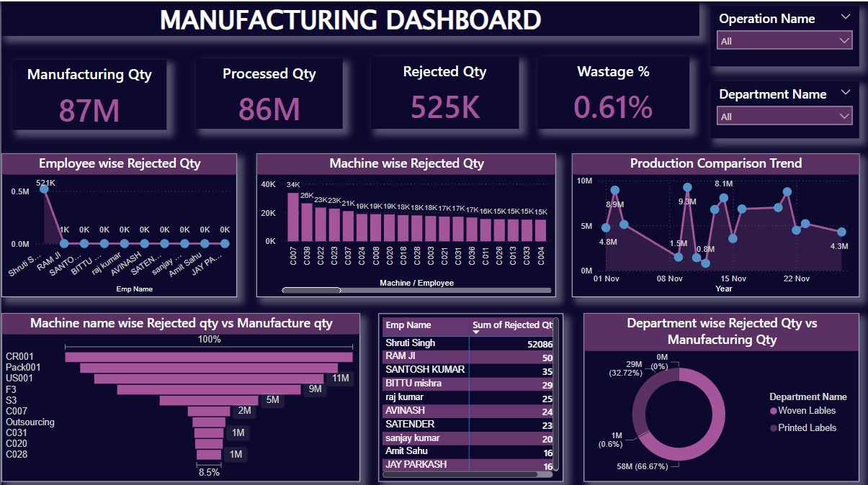
POWER BI DASHBOARD

Slide 6
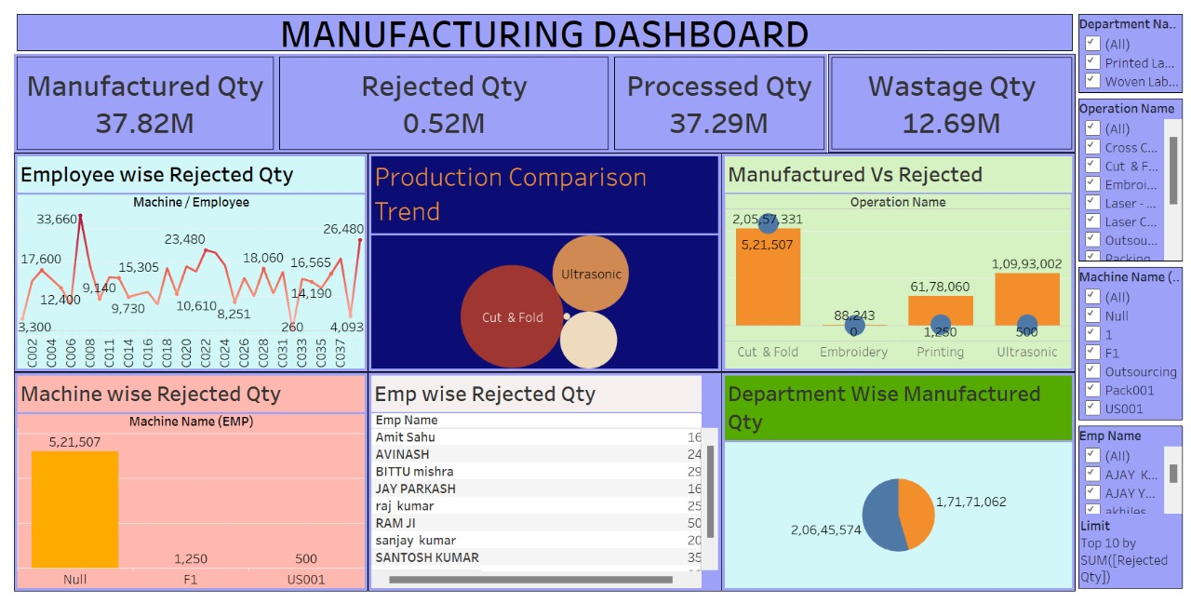
TABLEAU DASHBOARD

Slide 7
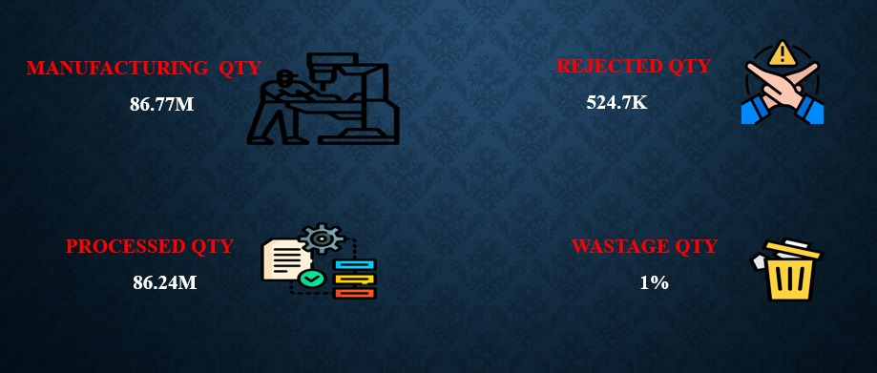
KEY METRICS

Slide 8
EMPLOYEE WISE REJECTED QTY
Analysis: Describe the bar chart that breaks down the rejected measure by each employee, which can identify employees who might need more training or support.
Insight: If certain employees have consistently high rejected measures, consider whether they may need additional guidance, training, or if they are handling more challenging tasks. Discuss potential corrective actions, such as specific skill development or pairing them with experienced employees.

Slide 9
MACHINE WISE REJECTED QTY
Analysis: Explain this bar chart that shows rejected quantities by machine or employee. Identify machines or employees with higher rejections, as this may indicate maintenance issues or areas where the process may not be optimized.
Optimization Opportunities: Machines with high rejection rates might need servicing or recalibration. If certain employees consistently reject high volumes, they may need targeted quality training or support.

Slide 10
PRODUCTION COMPARISION TREND
Description: Use the line chart to illustrate how the manufacture measure has varied across the month. This visual helps identify trends, peaks, and troughs in production volume.
Insights: Look for patterns (e.g., weekly highs, post-maintenance increases) and discuss possible reasons behind them. For instance, if there's a peak after maintenance or a dip before the weekend, these could be operational insights related to workforce or machine scheduling.
Operational Factors: Explain how factors like machine downtime, employee shifts, or seasonal demand can influence these trends, allowing for more accurate future planning.

Slide 11
MANUFACTURE QTY VS REJECTED QTY
The "Manufacture vs Rejected Qty" KPI highlights the relationship between the total production output and the amount of rejected items, offering critical insights into production efficiency and quality control. A high rejection rate compared to the manufactured quantity often indicates underlying inefficiencies such as process flaws, equipment issues, or skill gaps among employees.
Highlight any machines with high rejection rates. This can indicate where maintenance, recalibration, or replacement may be needed. Machines with consistently low rejections could be benchmarked for best practices.

Slide 12
DEPT WISE MANUFACTURE VS REJECTED
The "Department Wise Manufacture Vs Rejected Qty" KPI provides a detailed view of how various departments contribute to overall production and the associated rejections. It helps identify disparities in performance and quality across departments, offering a pathway for targeted improvement.
Consistently high rejection rates in certain departments could also point to misaligned workloads, inadequate training, or recurring issues with specific raw materials or processes.

Slide 13
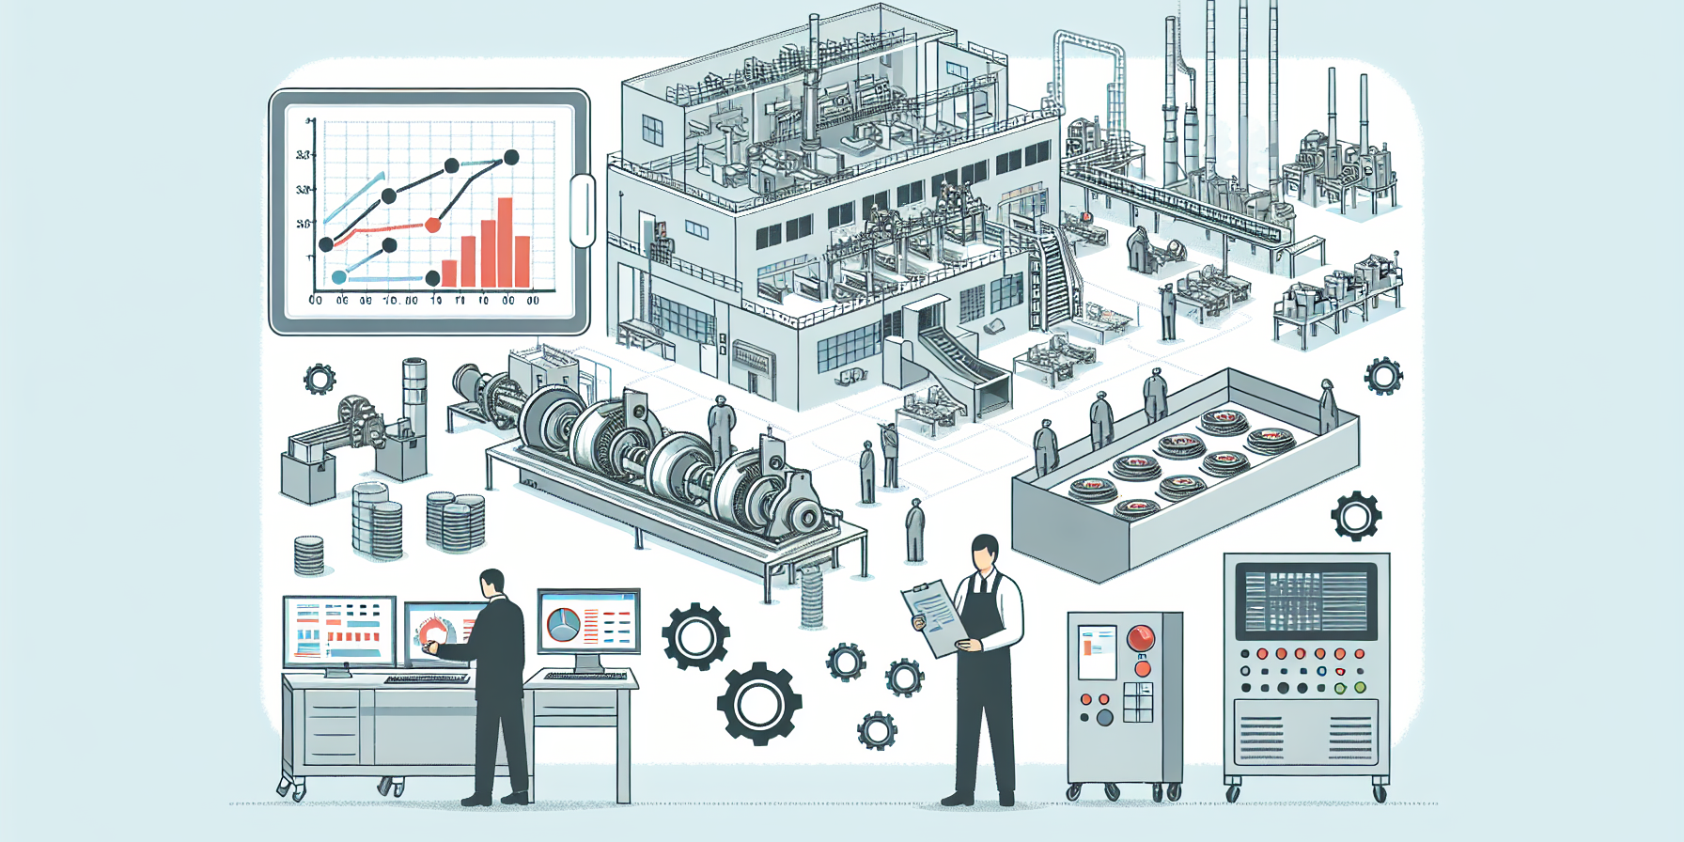
CONCLUSION
The dataset is a comprehensive record of production and operational metrics, comprising 10,679 entries across 68 attributes. It captures details on buyers, production schedules, machine usage, and financial performance, providing insights into manufacturing efficiency and output. While the dataset is rich in information, it contains missing values in key fields like customer details and machine codes, which may require cleaning for analysis. Numerical columns exhibit significant variability, suggesting diverse production scales and financial outcomes. Overall, the dataset is well-suited for performance evaluation, trend analysis, and identifying operational bottlenecks.

Slide 14

THANK YOU

